Slide 1
Crunching GPUs Easily Using CUDA Python
Le[on Jaramillo
April 2026

Slide 2
Contents
Crunching GPUs Easily Using CUDA Python
01 | Are really GPUs a big thing? |  | 04 | What is CUDA?
02 | CPU or GPU? |  | 05 | What is CUDA Python?
03 | GPU architecture |  | 06 | Call to Action
Goal: know when to use PyTorch, cuDF, CuPy, or Numba.

Slide 3
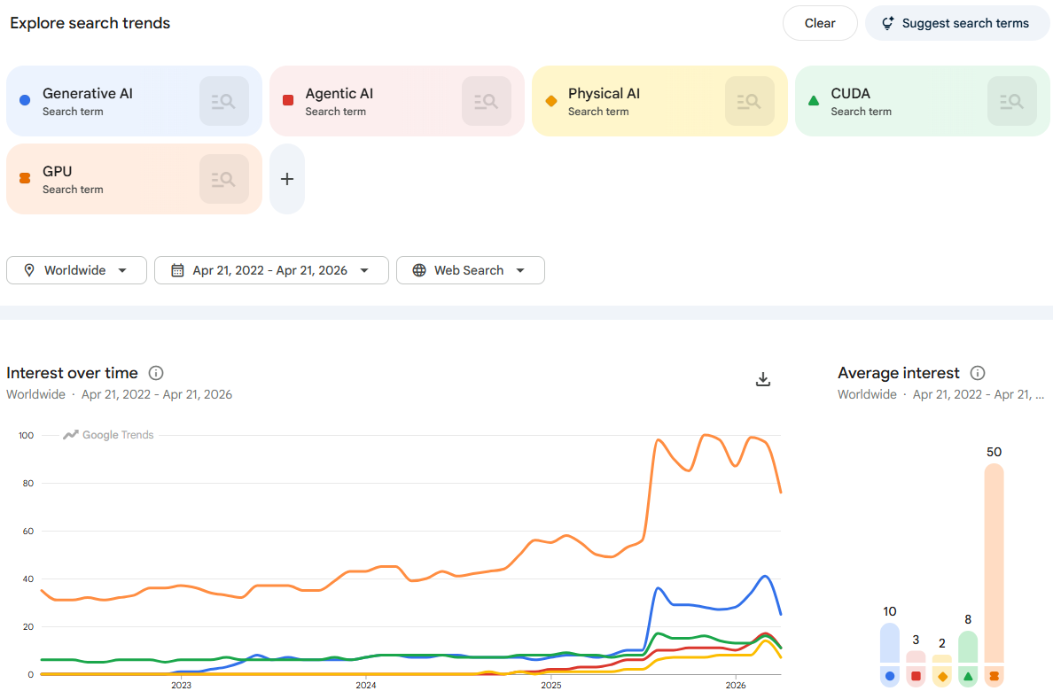
Are really GPUs a big thing?
Crunching GPUs Easily Using CUDA Python
There is a high correlation between the AI boom and the interest on its underlying GPU tooling.
Source: https://trends.google.com/explore?date=2022-04-21%202026-04-21&geo=Worldwide&q=Generative%2520AI%2CAgentic%2520AI%2CPhysical%2520AI%2CCUDA%2CGPU

Slide 4
CPU or GPU? Why does this choice matter now?
Crunching GPUs Easily Using CUDA Python
More teams can use GPUs now
GPUs are more accessible than before
Cloud and Colab-style environments reduce the barrier
Python users can benefit without starting from CUDA C++
Modern workloads changed
AI and data workloads keep growing
Many tasks are numeric and parallel
Performance and experimentation speed matter more
But CPU still matters
Not every workload benefits from a GPU
Transfer overhead and memory constraints matter
The real question is: which processor fits the workload?

Slide 5
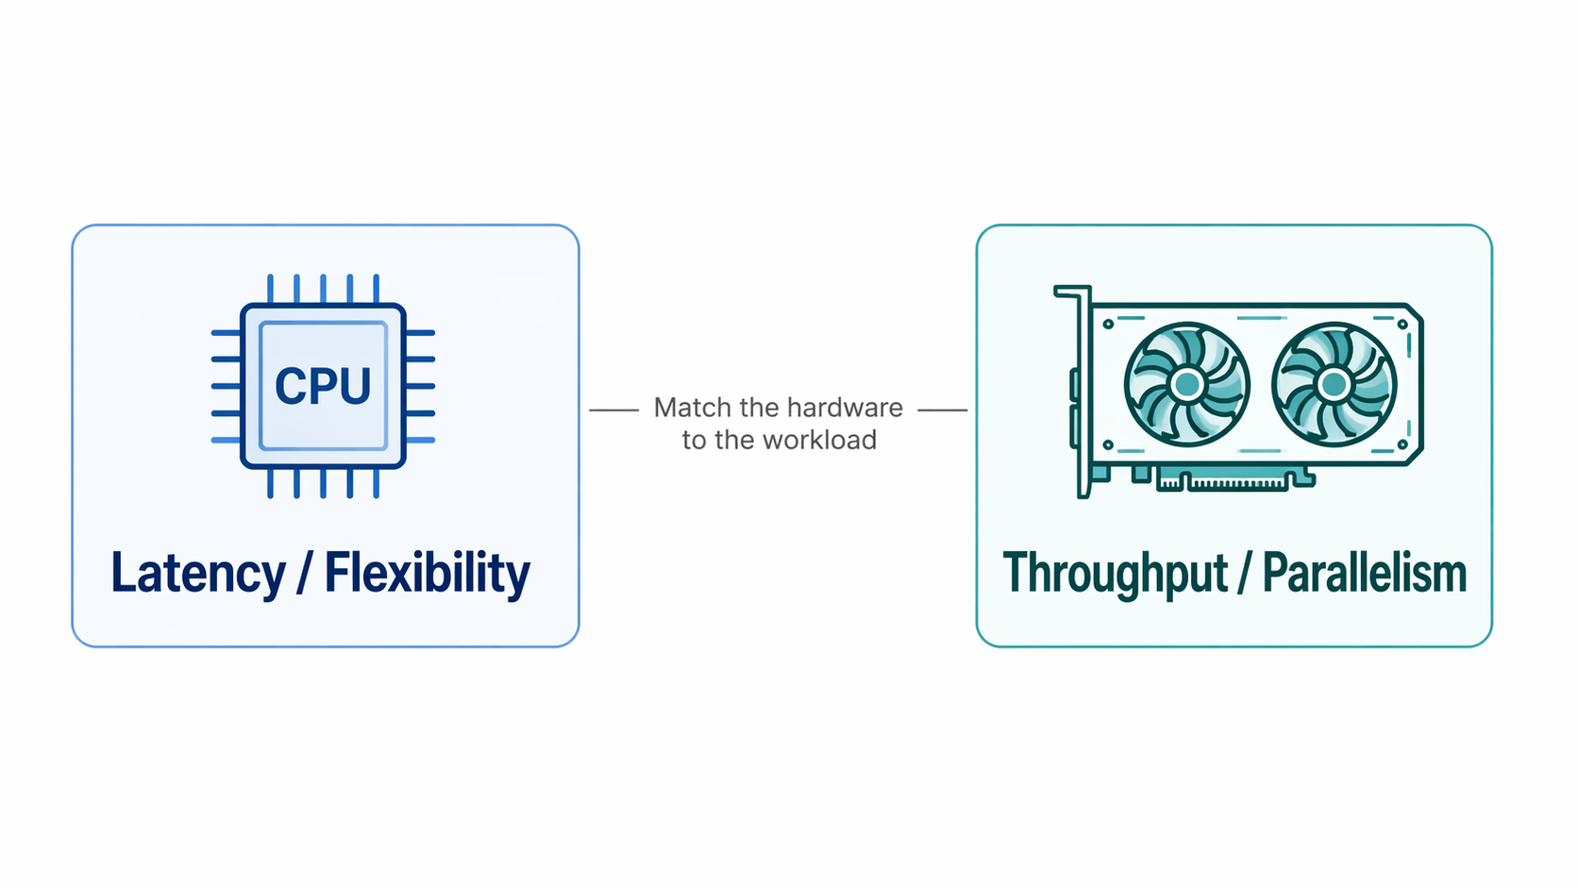
CPU or GPU? Choose by workload
Crunching GPUs Easily Using CUDA Python
Use CPU when…
You need low latency
The logic is irregular or branch-heavy
The workload is small or moderately sized
You need more memory capacity
The data already lives on the host
Use GPU when…
You need high throughput
The work is highly parallel
Operations are mostly numeric / tensor / dataframe
The workload is large enough to amortize transfers
The data can stay on the device

Slide 6
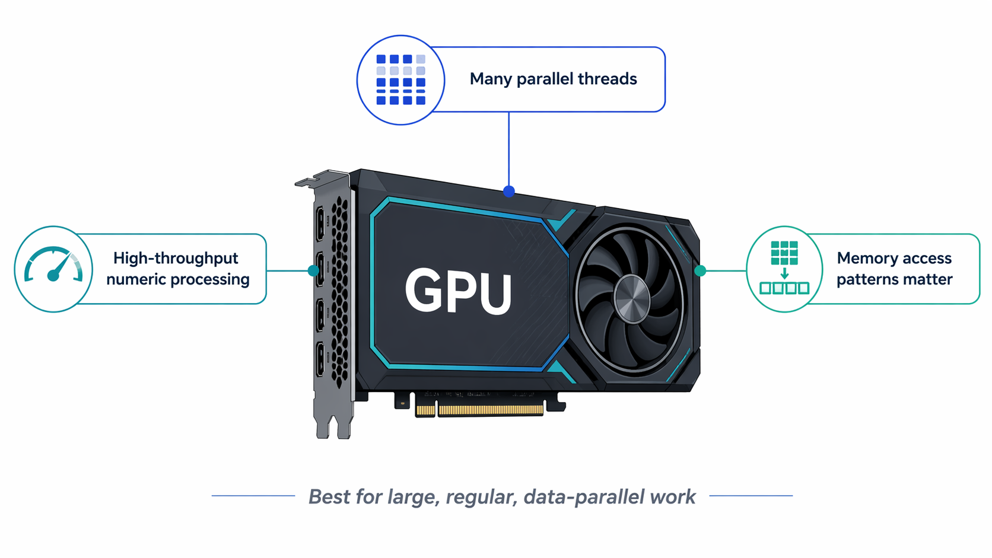
GPU architecture key features
Crunching GPUs Easily Using CUDA Python
Massive parallelism
High-throughput design
Memory hierarchy matters
Best with regular workloads
Many lightweight threads process data simultaneously
Optimized for total work done, not lowest latency
Access patterns and locality strongly affect performance
Repeated operations over large datasets work best

Slide 7
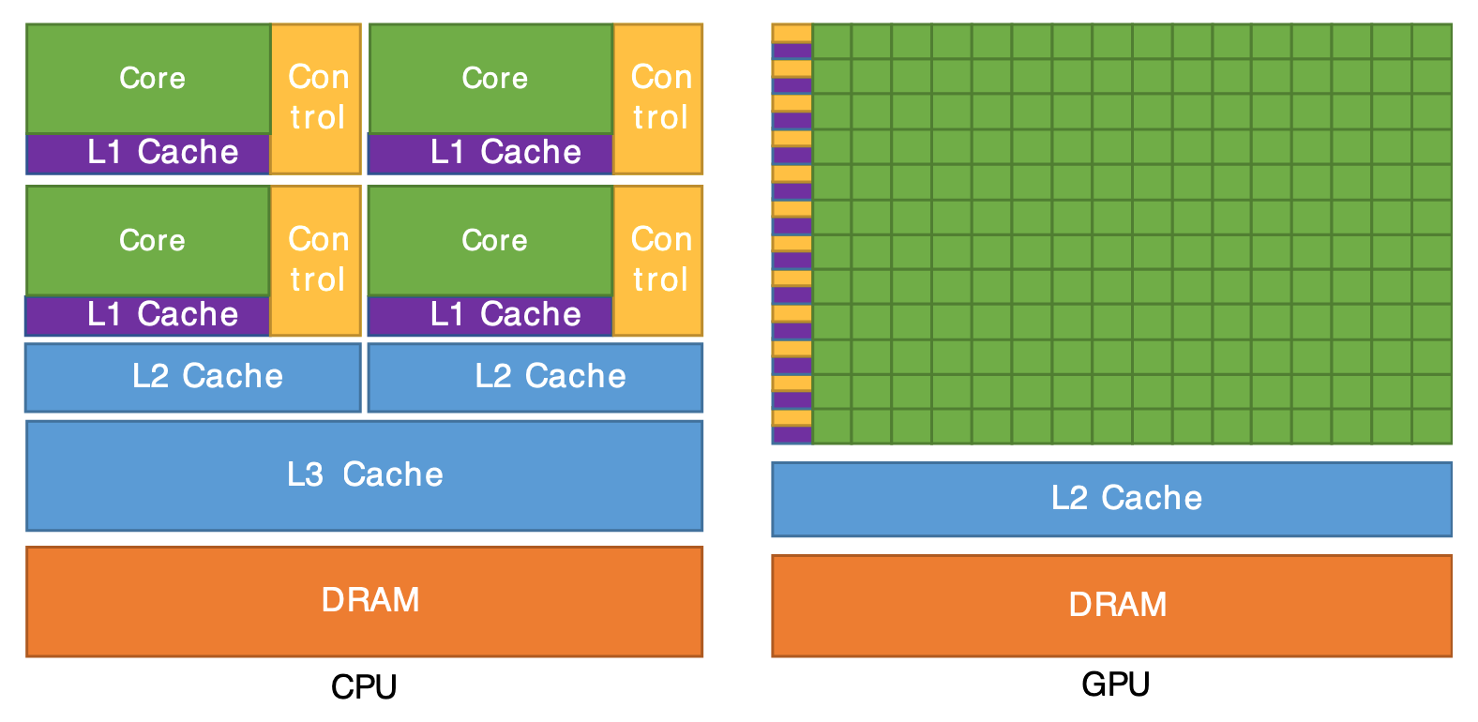
A GPU (and a CPU) looks like this
Crunching GPUs Easily Using CUDA Python
Please note that the schema above is not at scale.

Slide 8
So, what is CUDA?
Crunching GPUs Easily Using CUDA Python
CUDA (Compute Unified Device Architecture) is NVIDIA’s parallel computing platform and API for general-purpose GPU computing. It implements the Single Instruction Multiple Threads (SIMT) paradigm.
CUDA provides
a programming model for parallel execution
libraries and runtime support for GPU computing
a way to launch work on NVIDIA GPUs
CUDA organizes work as
kernels
threads
blocks
grids
Why it matters in this talk
Python GPU libraries build on top of CUDA
higher-level tools hide complexity
lower-level tools expose more control

Slide 9
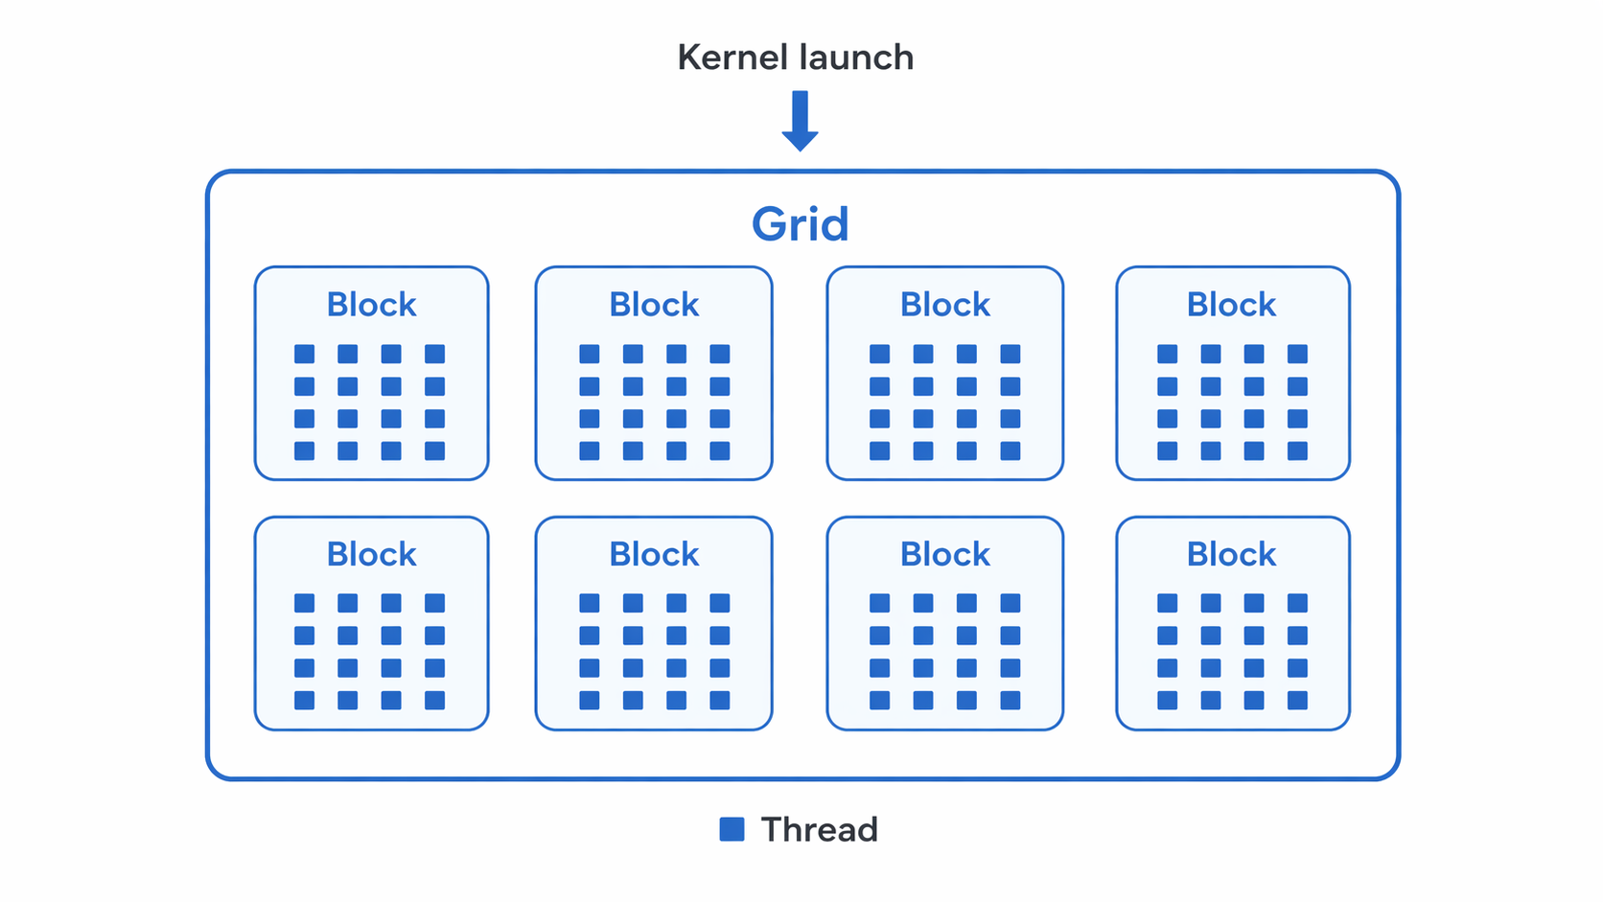
CUDA execution model: how work is organized
Crunching GPUs Easily Using CUDA Python
Kernel: The CUDA function that runs on the GPU.
Grid: Collection of blocks launched to execute the kernel (SIMT).
Block: A collection of threads with a shared memory.
Thread: Runs the kernel function on specific data (can be thousands).

Slide 10
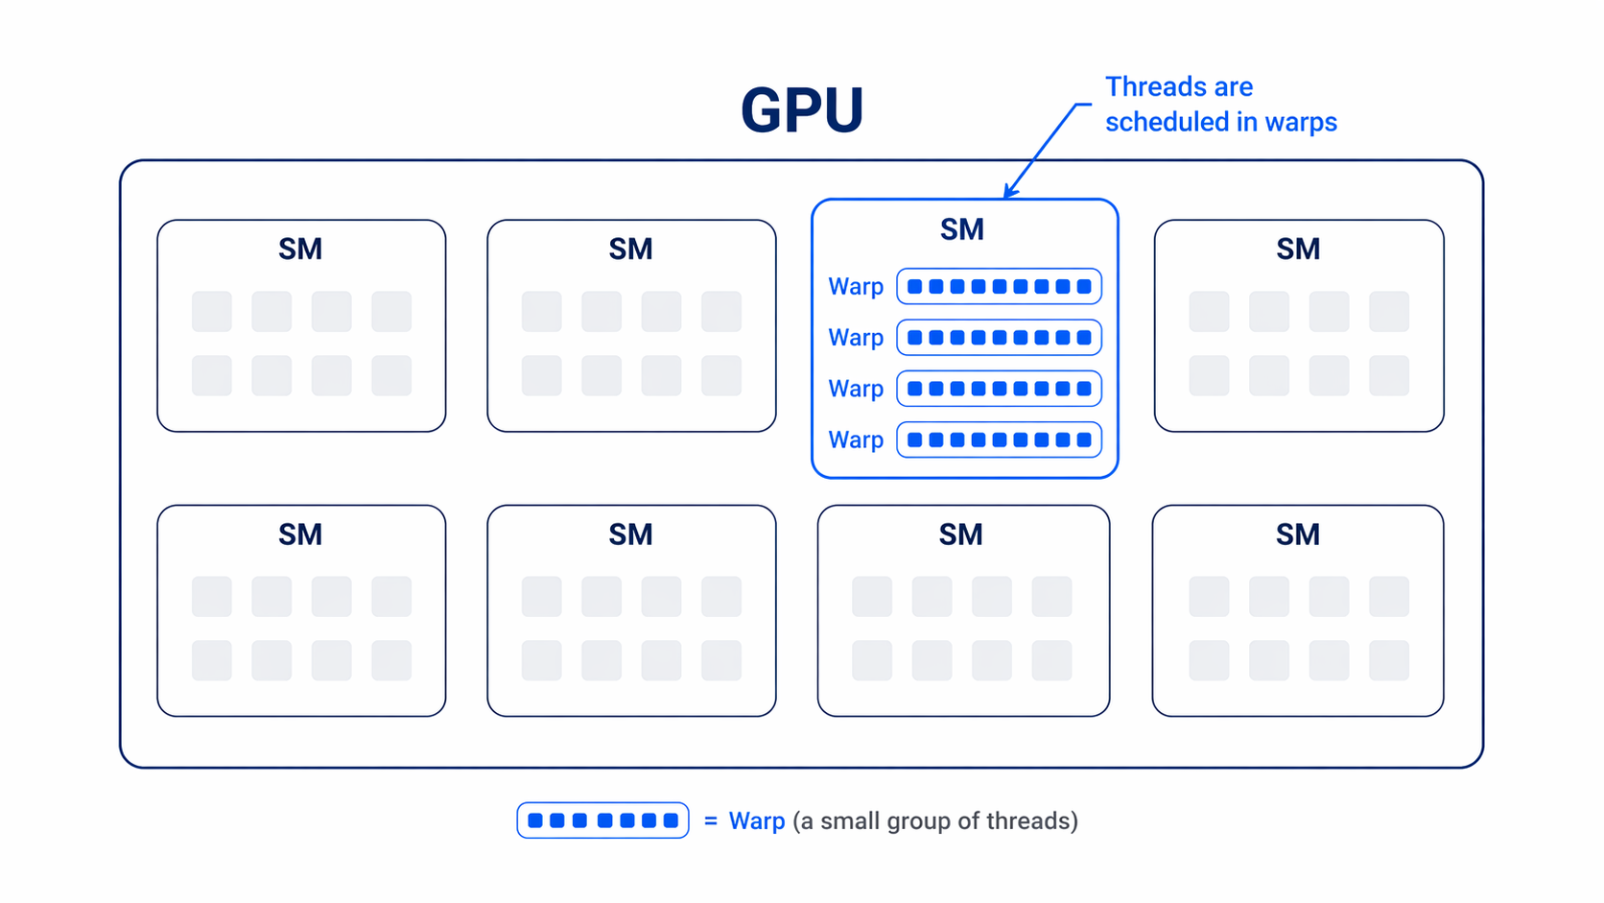
GPU hardware hierarchy: where that work runs
Crunching GPUs Easily Using CUDA Python
GPU: It’s the whole hardware device.
Streaming Multiprocessor (SM): A GPU has many of them, executing many blocks in parallel as scheduled.
Warp: A SM has many warps, being its basic unit, with 32 threads each, executing instructions in lockstep.
CUDA Core: Executes threads.

Slide 11
A CUDA kernel
Crunching GPUs Easily Using CUDA Python
When using CUDA, you write a kernel, which can be launched and therefore executed on thousands of threads by CUDA cores, reaching massive throughput:
__global__ void vec_add(const float* a, const float* b, float* c, int n) {
int i = blockIdx.x * blockDim.x + threadIdx.x; // global thread id
if (i < n) c[i] = a[i] + b[i];
}
vec_add<<<blocks, threads>>>(d_a, d_b, d_c, n);
There is a way to do this much easier… using CUDA Python.

Slide 12
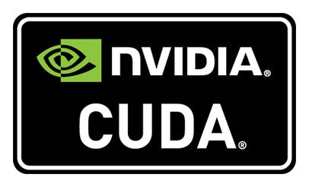



Then, what is CUDA Python?
Crunching GPUs Easily Using CUDA Python
CUDA Python refers to the ecosystem of tools and libraries that let us use CUDA within Python workflows.
Now, we don’t need deep C++ or Fortran knowledge, leveraging native Python interfaces for GPU acceleration.
NVIDIA provides a standard set of interfaces known as the CUDA Python package to unify the ecosystem.
Within the scope of CUDA Python, here are several libraries which leverage GPU acceleration in different applications, such as Numba, CuPy, and RAPIDS.

Slide 13
CUDA Python Tooling
Crunching GPUs Easily Using CUDA Python
PyTorch: High-level deep learning framework with CUDA-enabled tensors and models on NVIDIA GPUs.
TensorFlow: ML framework whose operations and tf.keras models can run on GPU, often with little or no code change.
Keras: High-level deep learning API; GPU execution comes through its backend, such as TensorFlow or PyTorch.
RAPIDS: GPU data science stack, centered on libraries such as cuDF for dataframes and cuML for machine learning.
cudf.pandas: Zero-code-change pandas acceleration on GPU, with automatic CPU fallback.
Polars GPU engine: cuDF-backed GPU engine for the Polars Lazy API, with CPU fallback when needed.
CuPy: NumPy/SciPy-compatible GPU array library for Python.
cuPyNumeric: Accelerated, scalable NumPy replacement built on Legate.
Numba: Lets you write CUDA kernels in Python; current CUDA work is moving to numba-cuda.
PyCUDA: Pythonic access to CUDA APIs and compiled CUDA kernels from Python.
cuTile: Advanced Python DSL for tile-based GPU kernels.
cuda-python: NVIDIA’s official Python access layer for CUDA, from Pythonic core APIs to low-level bindings.

Slide 14
Ladder of abstraction
Crunching GPUs Easily Using CUDA Python
Deep Learning
PyTorch
TensorFlow
Data Science
RAPIDS
Numeric tasks
CuPy
cuPyNumeric
Custom kernels
Numba
PyCUDA
cuTile
Keras
cudf.pandas
cuda-python
Polars GPU engine

Slide 15


Main Choices when Writing CUDA Kernels with Python
Crunching GPUs Easily Using CUDA Python
Numba
Python-style CUDA kernels
Good default for custom kernels
Best for thread/block-oriented programming
cuTile
Tile-based Python DSL
Load tile → compute → store tile
Best for advanced, high-performance kernels
Requires, at least, GPUs with Turing architecture

Slide 16

How to use CUDA Python?
Crunching GPUs Easily Using CUDA Python
PyTorch
RAPIDS
CuPy
Numba
Just check this repo: https://github.com/leonjaramillo/crunching-gpus
And run the code with a CUDA capable PC or even in Google Colab.

Slide 17
Call to Action: How to get started today!
Crunching GPUs Easily Using CUDA Python
Check your GPU and driver
Pick one real workload
Start at the highest useful layer
Verify correctness before timing
Package the environment and keep a CPU fallback

Slide 18
Thank you!
Q&A

